Slide 1
Lyrics to Audio Alignment
Hasan Khadra, Dimitriu Andrada

Slide 2
What it is
Task: Given a song’s audio and its lyrics, assign a precise timestamp to each word
Applications: Karaoke / lyrics sync • Spotify word-by-word highlight • Accessibility subtitles • Music education

Slide 3
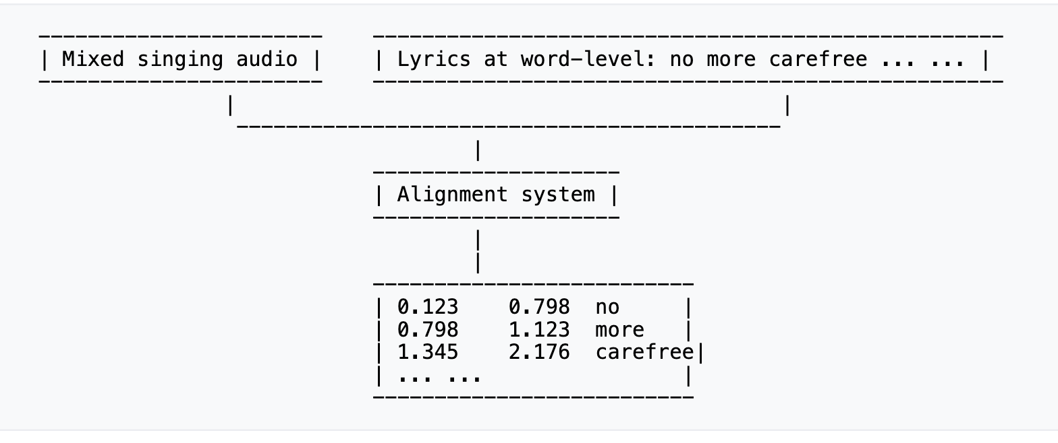
Input and Output

Slide 4
Open Datasets
Dali
Over 5000 songs
Semi-automatically aligned lyrics annotations
Songs - commercial recordings in full-duration
Lyrics are described according to different levels of granularity including words and notes (and syllables underlying a given note).
Damp
300 songs
34000+ of a cappella recordings from a wide variety of amateur singers
No lyrics boundary annotations are available
curated subset DAMPB of 20 performances of each song

Slide 5
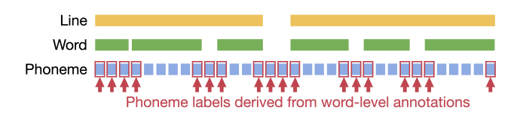
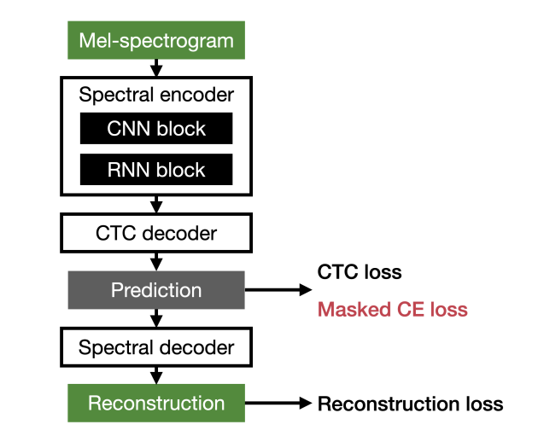
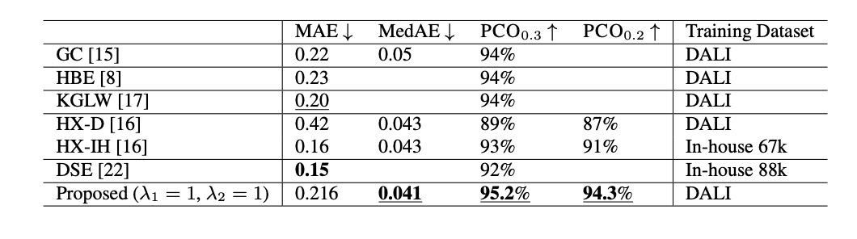
Improving Lyrics-to-Audio Alignment Using Frame-Wise Phoneme Labels With Masked Cross Entropy Loss, 2025
HT Demucs - extract the singing vocals - public
Autoencoder trained with a CTC loss( Connectionist Temporal Classification) and a reconstruction loss.
Adds partial phenome-level information.
masked frame-wise CE loss
considers only frames with known phoneme labels.

Slide 6
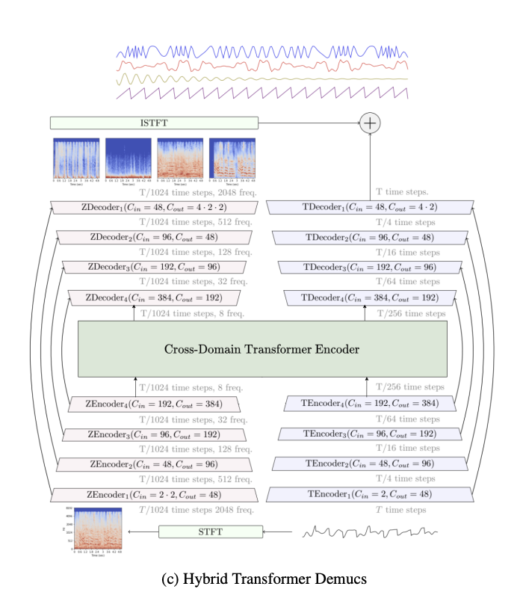
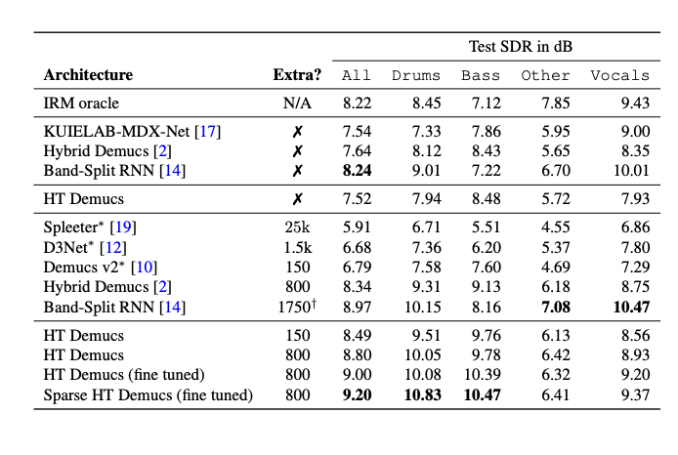
Hybrid Transformer Demucs for MSS, 2023
Based on Hybrid Demucs - Hybrid temporal/spectral bi-U-Net
Innermost convolutional layers layers are replaced by a cross-domain Transformer Encoder
Uses self-attention within one domain, and cross-attention across domains

Slide 7
Plan
Separate Voice from music using HT Demucs
Apply autoencoder trained with a CTC loss
Adds partial phenome-level information.

Slide 8
Previous work
Lyrics-to-Audio Alignment and Lyrics Transcription:
GGL1(2020) - a factorized time-delay neural network (TDNNF) architecture
GGL2(2020) - like GGL1 + additional convolutional layers (2 convolutional, 10 time-delay layers followed by a rank reduction layer)
Improving Lyrics-to-Audio Alignment (2025)
Using frame-wise phoneme labels with masked cross entropy loss
Trained on top of self-supervised audio representations (wav2vec 2.0)
CTC-based Forced Alignment (2022-present)
Whisper + CTC decoder: word-level timestamps via torchaudio forced aligner
Currently dominant approach in production (Spotify, Apple Music)

Slide 9
Possible Approaches
1. HMM-based Forced Alignment (classical baseline)
Phoneme-level acoustic model + Viterbi decoding to align text to audio
Well-understood but limited by acoustic model quality on singing voice
2. TDNNF Acoustic Models (GGL1 / GGL2)
Time-delay neural networks trained specifically on singing audio
Dataset: DALI + DAMP for training and evaluation
3. CTC-based Alignment with Self-Supervised Models
Fine-tune wav2vec 2.0 or Whisper encoder + CTC forced aligner for word timestamps
Modern approach — currently used in production by Spotify and Apple Music

Slide 10
Thank you! Questions?

